Slide 1




Algorithm and Experiment Design with HeuristicLab
An Open Source Optimization Environment for Research and Education
S. Wagner, G. Kronberger
Heuristic and Evolutionary Algorithms Laboratory (HEAL)
School of Informatics/Communications/Media, Campus Hagenberg
University of Applied Sciences Upper Austria

Slide 2


Instructor Biographies
Stefan Wagner
Full professor for complex software systems (since 2009) University of Applied Sciences Upper Austria
Co-founder of the HEAL research group
Project manager and chief architect of HeuristicLab
PhD in technical sciences (2009) Johannes Kepler University Linz, Austria
Associate professor (2005 – 2009) University of Applied Sciences Upper Austria
http://heal.heuristiclab.com/team/wagner
Gabriel Kronberger
Full professor for business intelligence (since 2011) University of Applied Sciences Upper Austria
Member of the HEAL research group
Architect of HeuristicLab
PhD in technical sciences (2010) Johannes Kepler University Linz, Austria
Research assistant (2005 – 2011) University of Applied Sciences Upper Austria
http://heal.heuristiclab.com/team/kronberger

Slide 3
Agenda
Objectives of the Tutorial
Introduction
Where to get HeuristicLab?
Plugin Infrastructure
Graphical User Interface
Available Algorithms & Problems
Demonstration Part I: Working with HeuristicLab
Demonstration Part II: Data-based Modeling
Some Additional Features
Planned Features
Team
Suggested Readings
Bibliography
Questions & Answers

Slide 4
Objectives of the Tutorial
Introduce general motivation and design principles of HeuristicLab
Show where to get HeuristicLab
Explain basic GUI usability concepts
Demonstrate basic features
Demonstrate editing and analysis of optimization experiments
Demonstrate custom algorithms and graphical algorithm designer
Demonstrate data-based modeling features
Outline some additional features

Slide 5
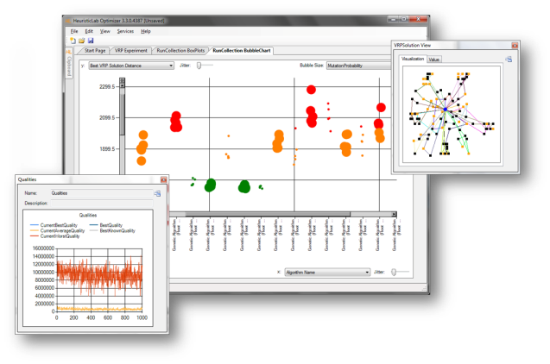
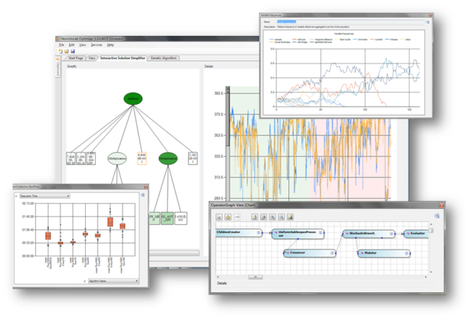

Introduction
Motivation and Goals
graphical user interface
paradigm independence
multiple algorithms and problems
large scale experiments and analyses
parallelization
extensibility, flexibility and reusability
visual and interactive algorithm development
multiple layers of abstraction
Facts
development of HeuristicLab started in 2002
based on Microsoft .NET and C#
used in research and education
second place at the Microsoft Innovation Award 2009
open source (GNU General Public License)
version 3.3.0 released on May 18th, 2010
latest version 3.3.10 released on July 10th, 2014

Slide 6
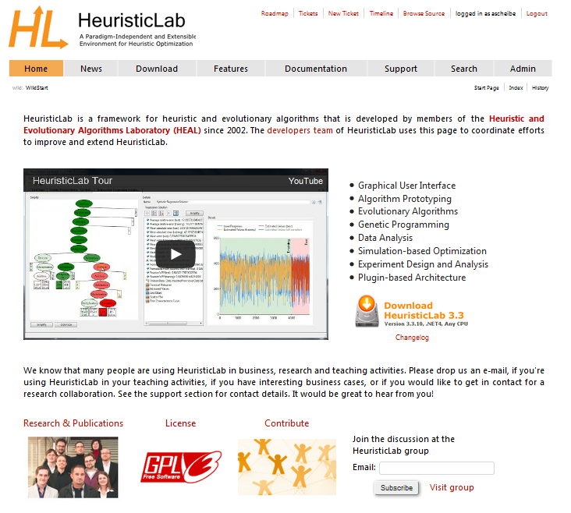
Where to get HeuristicLab?
Download binaries
deployed as ZIP archives
latest stable version 3.3.10
released on July 10th, 2014
daily trunk builds
http://dev.heuristiclab.com/download
Check out sources
SVN repository
HeuristicLab 3.3.10 tag
https://svn.heuristiclab.com/svn/core/tags/3.3.10
Stable development version
https://svn.heuristiclab.com/svn/core/stable
License
GNU General Public License (Version 3)
System requirements
Microsoft .NET Framework 4.0 Full Version
enough RAM and CPU power ;-)

Slide 7
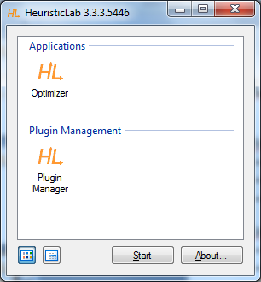
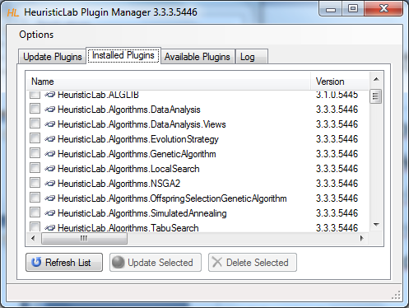
Plugin Infrastructure
HeuristicLab consists of many assemblies
158 plugins in HeuristicLab 3.3.10
plugins can be loaded or unloaded at runtime
plugins can be updated via internet
application plugins provide GUI frontends
Extensibility
developing and deploying new plugins is easy
dependencies are explicitly defined, automatically checked and resolved
automatic discovery of interface implementations (service locator pattern)
Plugin Manager
GUI to check, install, update or delete plugins

Slide 8
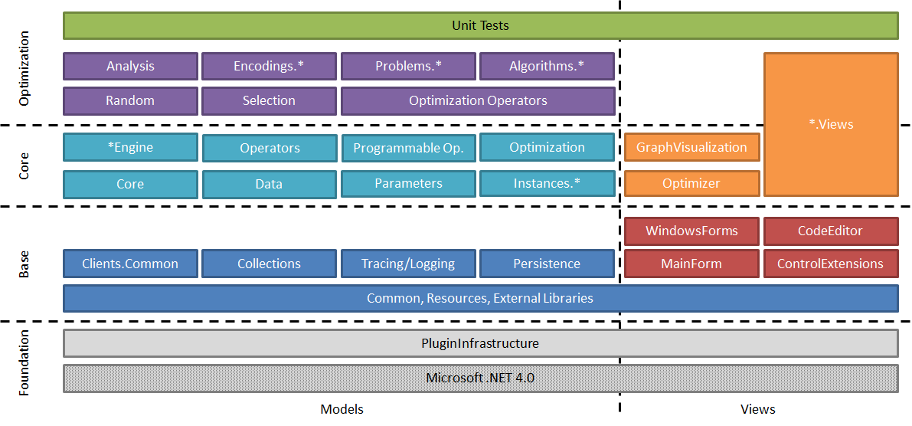
Plugin Architecture

Slide 9
Graphical User Interface
HeuristicLab GUI is made up of views
views are visual representations of content objects
views are composed in the same way as their content
views and content objects are loosely coupled
multiple different views may exist for the same content
Drag & Drop
views support drag & drop operations
content objects can be copied or moved (shift key)
enabled for collection items and content objects

Slide 10
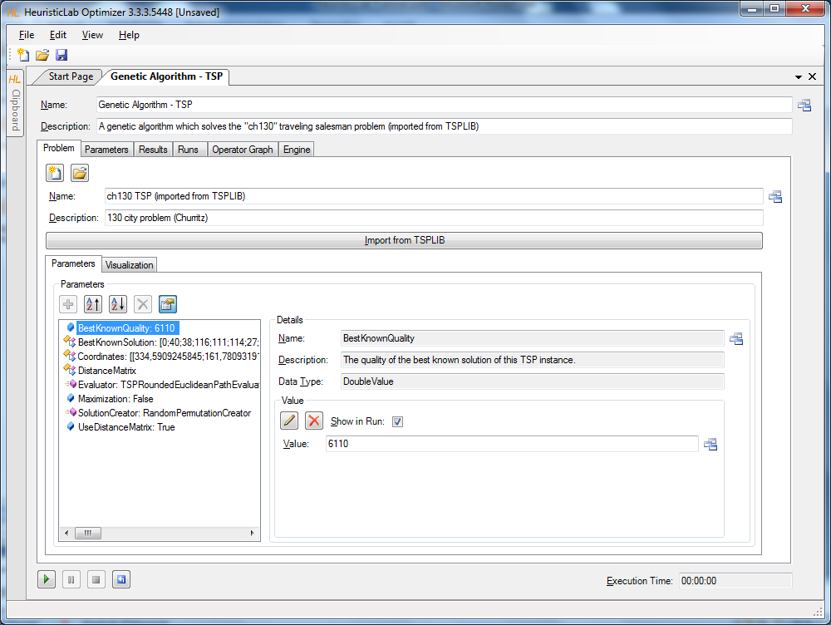
Graphical User Interface
Algorithm View
Problem View
Parameter Collection View
Parameter View
Double Value View

Slide 11
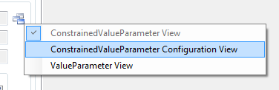
Graphical User Interface
ViewHost
control which hosts views
right-click on windows icon to switch views
double-click on windows icon to open another view
drag & drop windows icon to copy contents

Slide 12
Available Algorithms
Population-based
CMA-ES
Evolution Strategy
Genetic Algorithm
Offspring Selection Genetic Algorithm
Island Genetic Algorithm
Island Offspring Selection Genetic Algorithm
SASEGASA
Relevant Alleles Preserving GA (RAPGA)
Genetic Programming
NSGA-II
Scatter Search
Particle Swarm Optimization
Trajectory-based
Local Search
Tabu Search
Robust Taboo Search
Variable Neighborhood Search
Simulated Annealing
Data Analysis
Linear Discriminant Analysis
Linear Regression
Multinomial Logit Classification
k-Nearest Neighbor
k-Means
Neighbourhood Component Analysis
Artificial Neural Networks
Random Forests
Support Vector Machines
Gaussian Processes
Additional Algorithms
User-defined Algorithm
Performance Benchmarks
Hungarian Algorithm
Cross Validation
LM-BFGS

Slide 13
Available Problems
Combinatorial Problems
Traveling Salesman
Vehicle Routing
Knapsack
Job Shop Scheduling
Linear Assignment
Quadratic Assignment
OneMax
Genetic Programming Problems
Symbolic Classification
Symbolic Regression
Symbolic Time-Series Prognosis
Artificial Ant
Lawn Mower
Additional Problems
Single-Objective Test Function
User-defined Problem
External Evaluation Problem (Anylogic, Scilab, MATLAB)
Regression, Classification, Clustering
Trading
Grammatical Evolution

Slide 14
Agenda
Objectives of the Tutorial
Introduction
Where to get HeuristicLab?
Plugin Infrastructure
Graphical User Interface
Available Algorithms & Problems
Demonstration Part I: Working with HeuristicLab
Demonstration Part II: Data-based Modeling
Some Additional Features
Planned Features
Team
Suggested Readings
Bibliography
Questions & Answers

Slide 15
Demonstration Part I: Working with HeuristicLab
Create, Parameterize and Execute Algorithms
Save and Load Items
Create Batch Runs and Experiments
Multi-core CPUs and Parallelization
Analyze Runs
Analyzers
Building User-Defined Algorithms

Slide 16
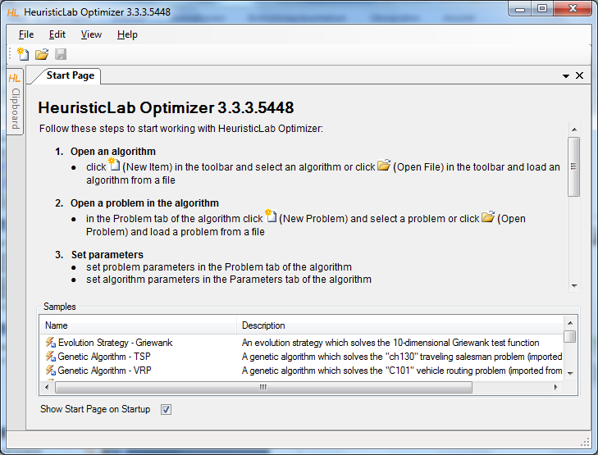
HeuristicLab Optimizer
double-click to open sample algorithms and problems

Slide 17
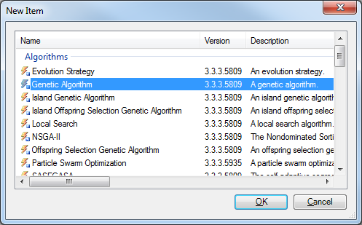
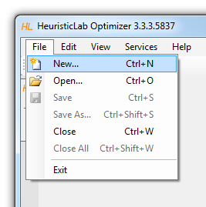
Create Algorithm

Slide 18
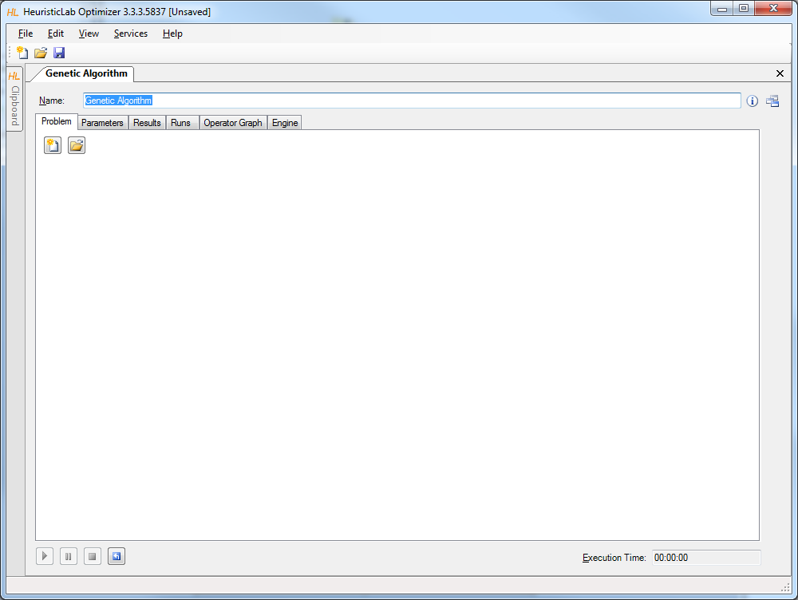
Create or Load Problem

Slide 19
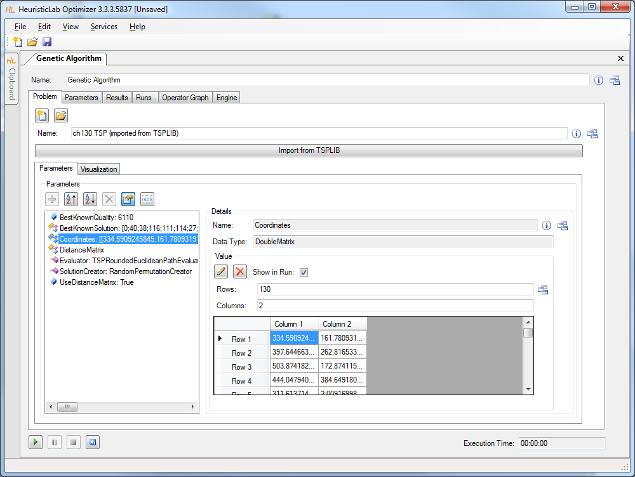
Import or Parameterize Problem Data

Slide 20
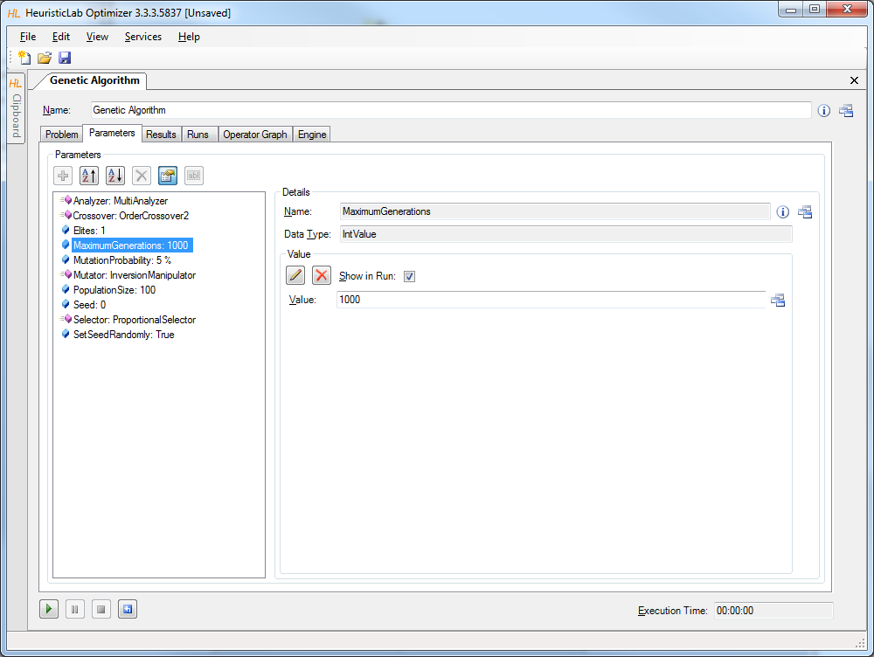
Parameterize Algorithm

Slide 21
Start, Pause, Resume, Stop and Reset

Slide 22
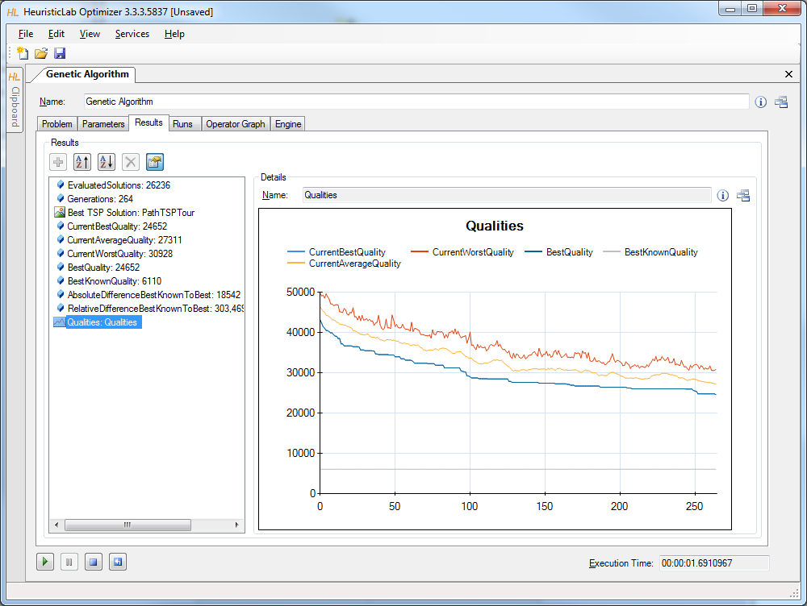
Inspect Results

Slide 23
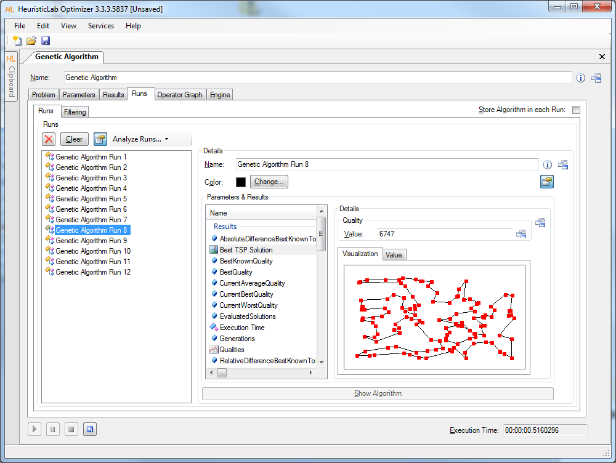
Compare Runs
A run is created each time when the algorithm is stopped
runs contain all results and parameter settings
previous results are not forgotten and can be compared

Slide 24
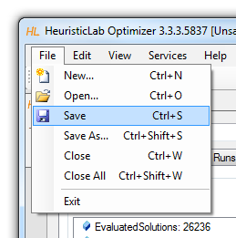
Save and Load
Save to and load from disk
HeuristicLab items (i.e., algorithms, problems, experiments, …) can be saved to and loaded from a file
algorithms can be paused, saved, loaded and resumed
data format is custom compressed XML
saving and loading files might take several minutes
saving and loading large experiments requires some memory

Slide 25
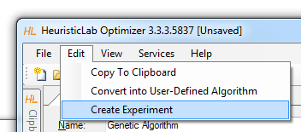
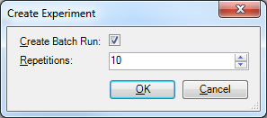
Create Batch Runs and Experiments
Batch runs
execute the same optimizer (e.g. algorithm, batch run, experiment) several times
Experiments
execute different optimizers
suitable for large scale algorithm comparison and analysis
Experiments and batch runs can be nested
Generated runs can be compared afterwards

Slide 26
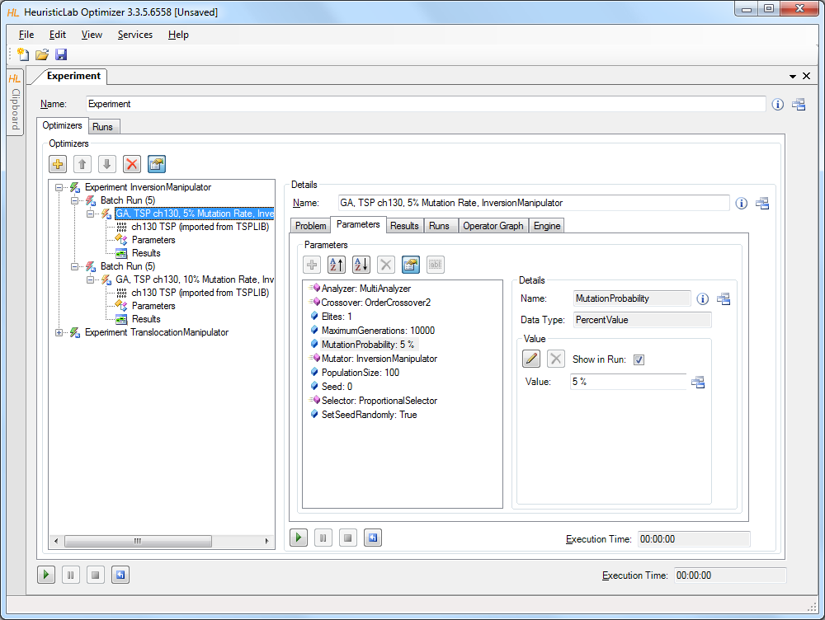
Create Batch Runs and Experiments
drag & drop here to add additional algorithms, batch runs, experiments, etc.

Slide 27
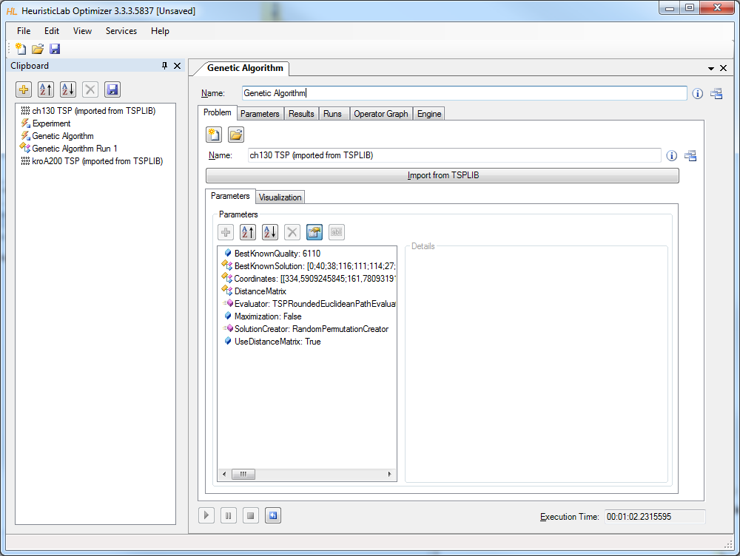
Clipboard
drag & drop here to add algorithms, problems, batch runs, experiments, etc.

Slide 28
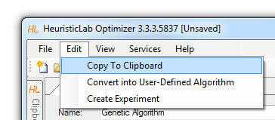
Clipboard
Store items
click on the buttons to add or remove items
drag & drop items on the clipboard
use the menu to add a copy of a shown item to the clipboard
Show items
double-click on an item in the clipboard to show its view
Save and restore clipboard content
click on the save button to write the clipboard content to disk
clipboard is automatically restored when HeuristicLab is started the next time

Slide 29
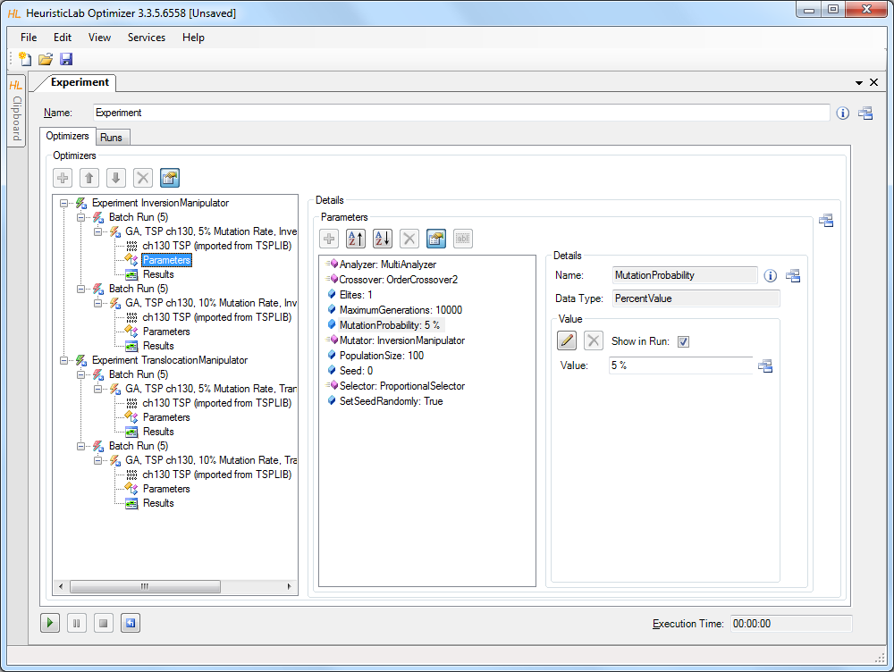
Start, Pause, Resume, Stop, Reset

Slide 30
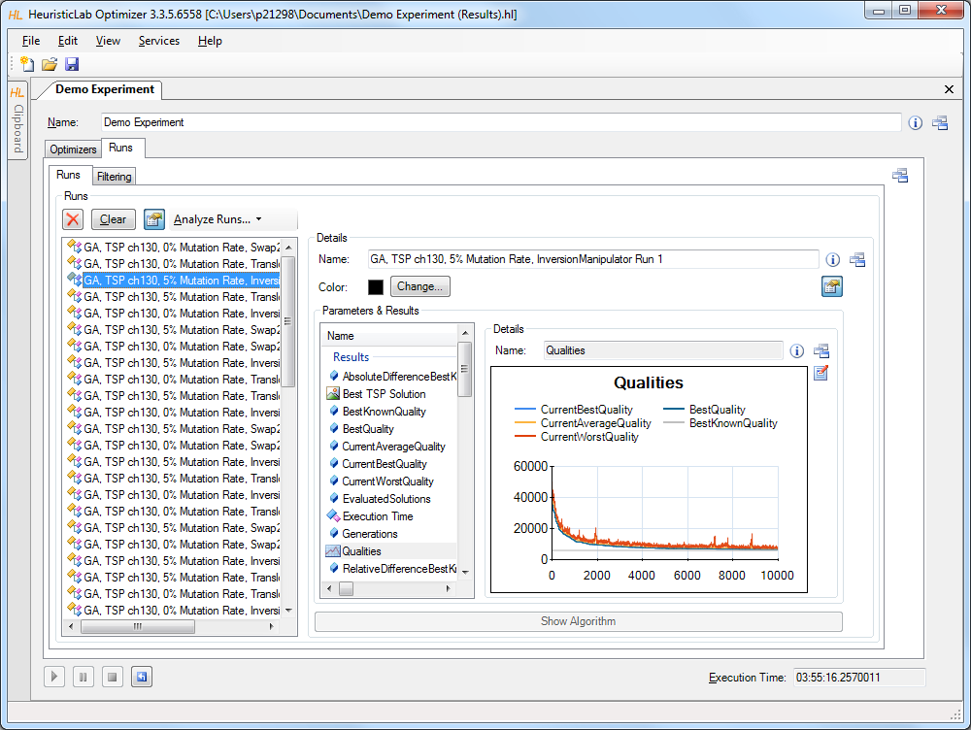
Compare Runs

Slide 31
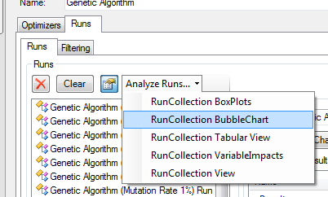
Analyze Runs
HeuristicLab provides interactive views to analyze and compare all runs of a run collection
textual analysis
RunCollection Tabular View
graphical analysis
RunCollection BubbleChart
RunCollection BoxPlots
Filtering is automatically applied to all open run collection views

Slide 32
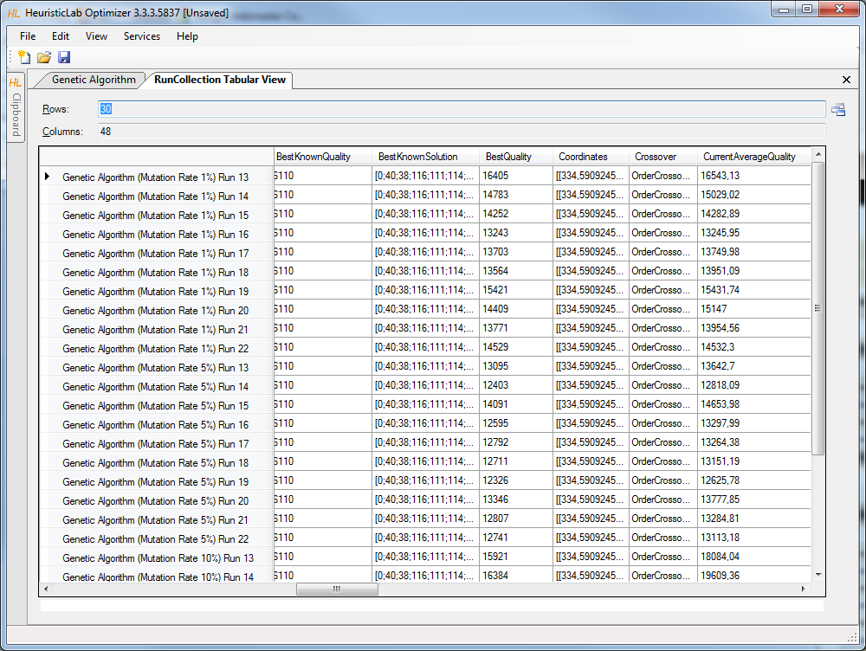
Runs – Tabular View

Slide 33
Runs – Tabular View
Sort columns
click on column header to sort column
Ctrl-click on column header to sort multiple columns
Show or hide columns
right-click on table to open dialog to show or hide columns
Compute statistical values
select multiple numerical values to see count, sum, minimum, maximum, average and standard deviation
Select, copy and paste into other applications

Slide 34
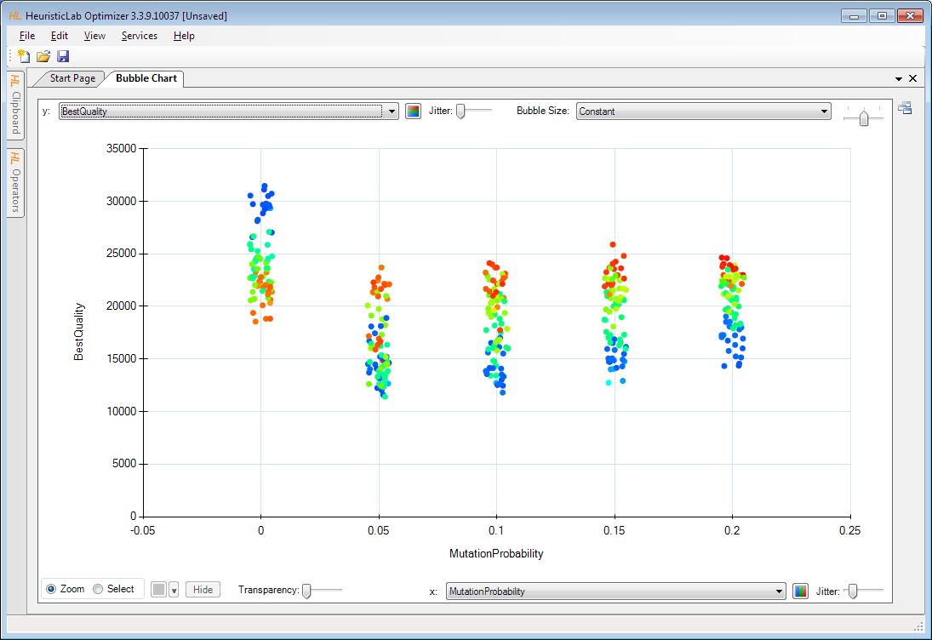
Runs – BubbleChart

Slide 35
Runs – BubbleChart
Choose values to plot
choose which values to show on the x-axis, the y-axis and as bubble size
possible values are all parameter settings and results
Add jitter
add jitter to separate overlapping bubbles
Zoom in and out
click on Zoom and click and drag in the chart area to zoom in
double click on the chart area background or on the circle buttons beside the scroll bars to zoom out
Color bubbles
click on Select, choose a color and click and drag in the chart area to select and color bubbles
apply coloring automatically by clicking on the axis coloring buttons
Show runs
double click on a bubble to open its run
Export image
right-click to open context menu to copy or save image
save image as pixel (BMP, JPG, PNG, GIF, TIF) or vector graphics (EMF)
Show box plots
right-click to open context menu to show box plots view

Slide 36
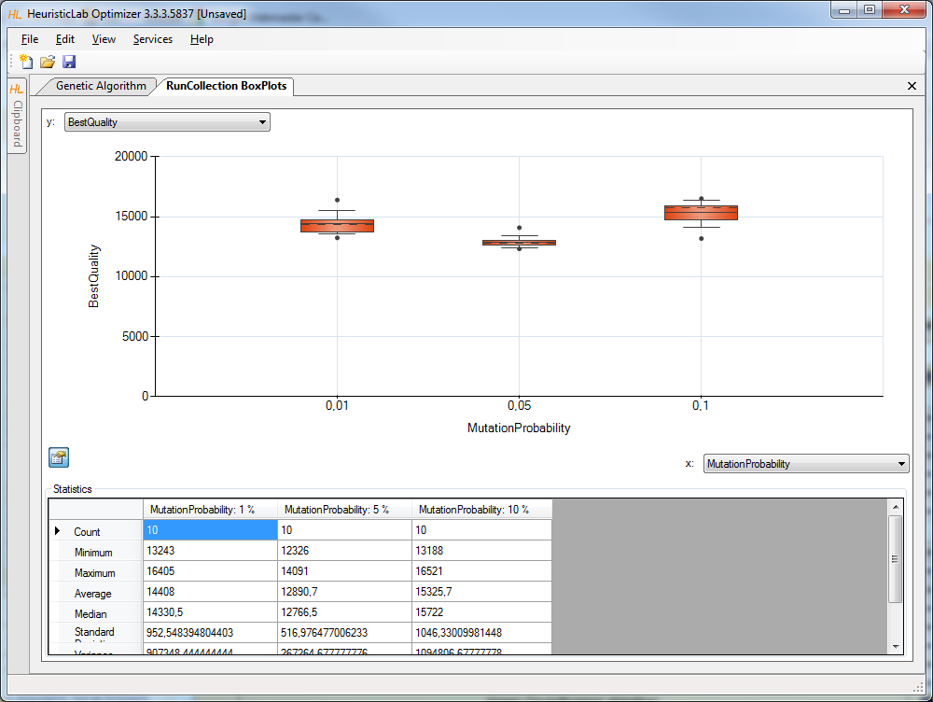
Runs – BoxPlots

Slide 37
Runs – BoxPlots
Choose values to plot
choose which values to show on the x-axis and y-axis
possible values are all parameter settings and results
Zoom in and out
click on Zoom and click and drag in the chart area to zoom in
double click on the chart area background or on the circle buttons beside the scroll bars to zoom out
Show or hide statistical values
click on the lower left button to show or hide statistical values
Export image
right-click to open context menu to copy or save image
save image as pixel (BMP, JPG, PNG, GIF, TIF) or vector graphics (EMF)

Slide 38
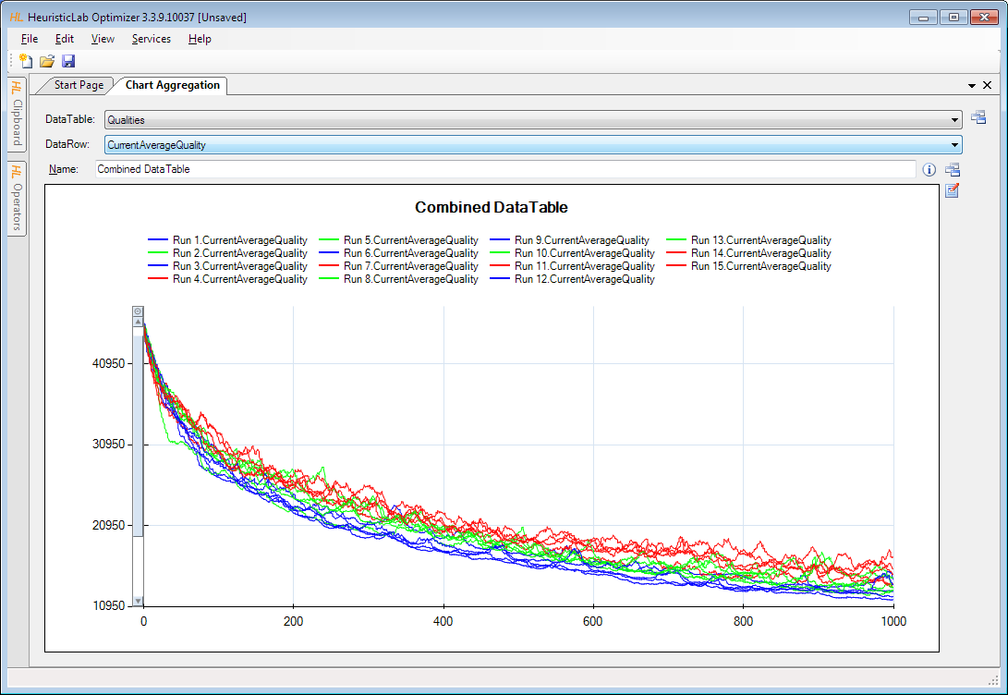
Runs – Multi-Line Chart

Slide 39
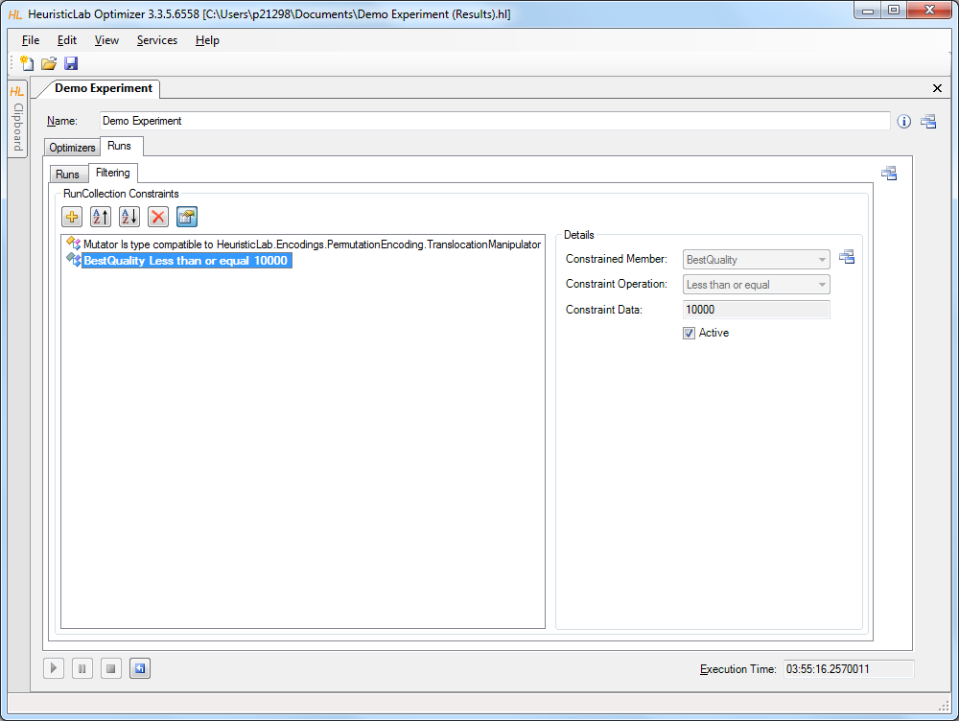
Filter Runs

Slide 40
Multi-core CPUs and Parallelization
Parallel execution of optimizers in experiments
optimizers in an experiment are executed sequentially from top to bottom per default
experiments support parallel execution of their optimizers
select a not yet executed optimizer and start it manually to utilize another core
execution of one of the next optimizers is started automatically after an optimizer is finished
Parallel execution of algorithms
HeuristicLab provides special operators for parallelization
engines decide how to execute parallel operations
sequential engine executes everything sequentially
parallel engine executes parallel operations on multiple cores
Hive engine (under development) executes parallel operations on multiple computers
all implemented algorithms support parallel solution evaluation

Slide 41
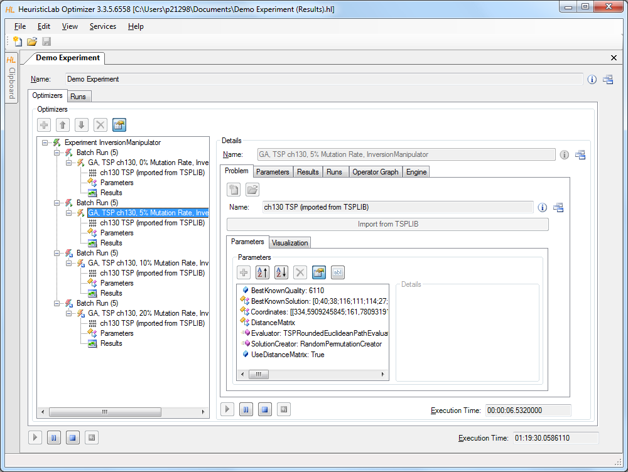
Parallel Execution of Experiments
2. start other optimizers
1. start experiment

Slide 42
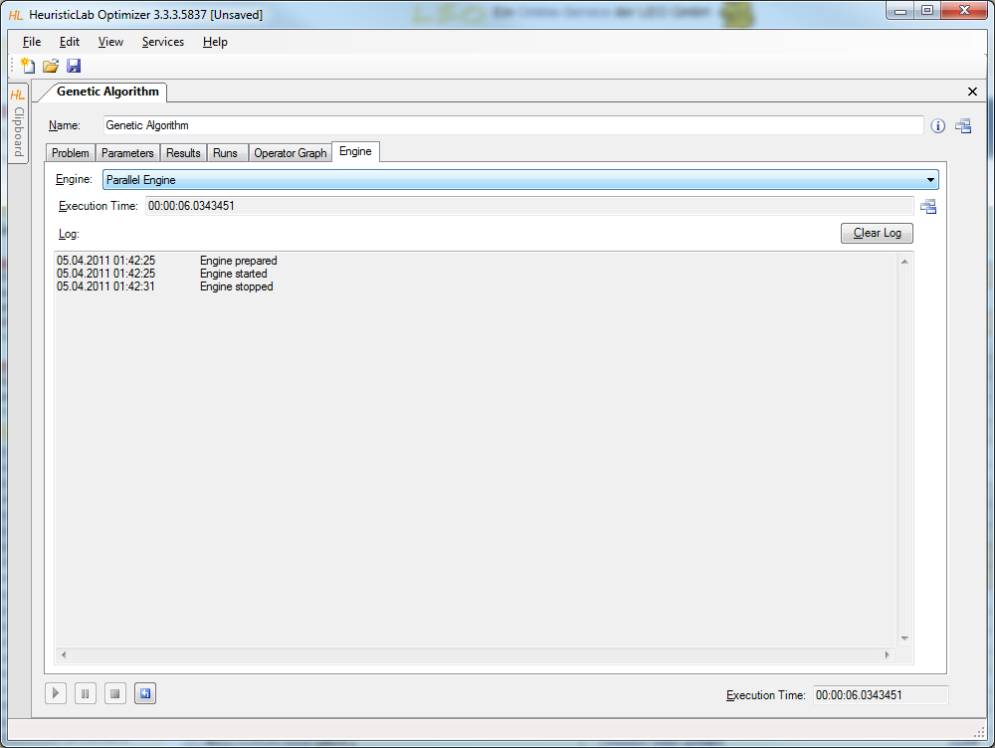
Parallel Execution of Algorithms

Slide 43
Analyzers
Special operators for analysis purposes
are executed after each iteration
serve as general purpose extension points of algorithms
can be selected and parameterized in the algorithm
perform algorithm-specific and/or problem-specific tasks
some analyzers are quite costly regarding runtime and memory
implementing and adding custom analyzers is easy
Examples
TSPAlleleFrequencyAnalyzer
TSPPopulationDiversityAnalyzer
SuccessfulOffspringAnalyzer
SymbolicDataAnalysisVariableFrequencyAnalyzer
SymbolicRegressionSingleObjectiveTrainingBestSolutionAnalyzer
…

Slide 44
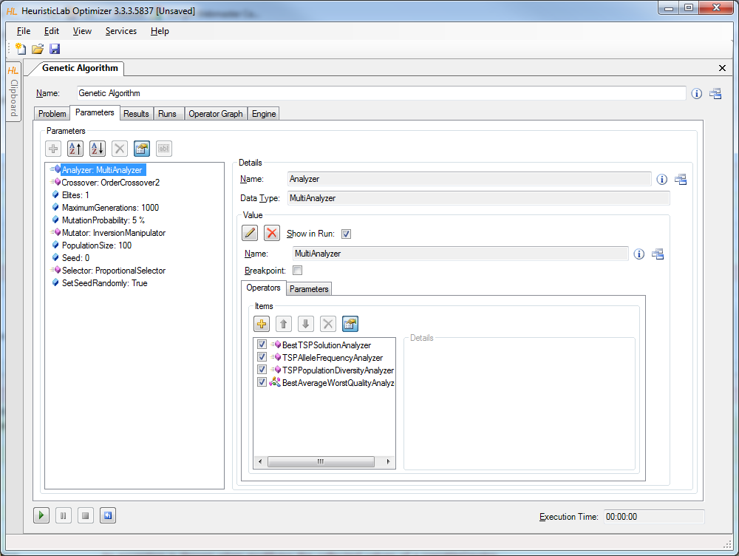
Analyzers

Slide 45
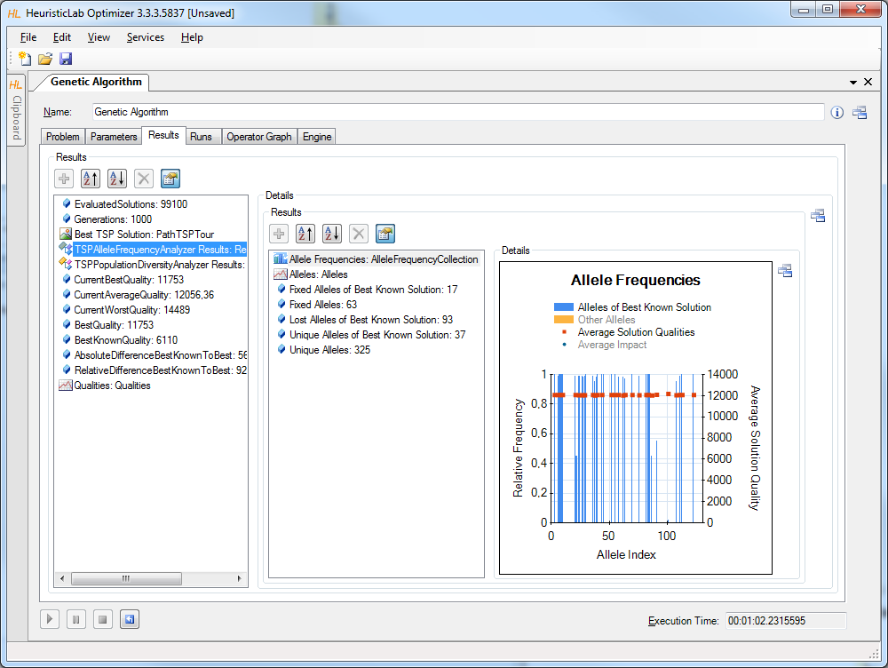
TSPAlleleFrequencyAnalyzer

Slide 46
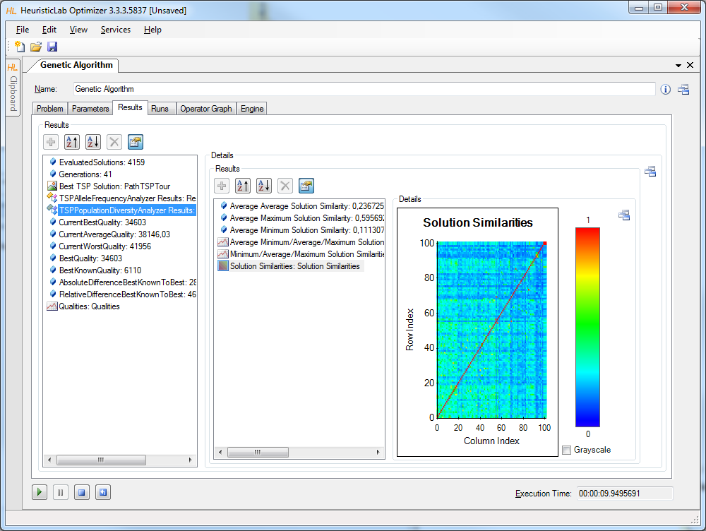
TSPPopulationDiversityAnalyzer

Slide 47
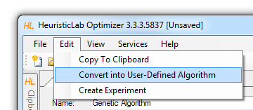
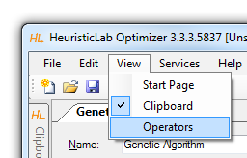
Building User-Defined Algorithms
Operator graphs
algorithms are represented as operator graphs
operator graphs of user-defined algorithms can be changed
algorithms can be defined in the graphical algorithm designer
use the menu to convert a standard algorithm into a user-defined algorithm
Operators sidebar
drag & drop operators into an operator graph
Programmable operators
add programmable operators in order to implement custom logic in an algorithm
no additional development environment needed
Debug algorithms
use the debug engine to obtain detailed information during algorithm execution

Slide 48
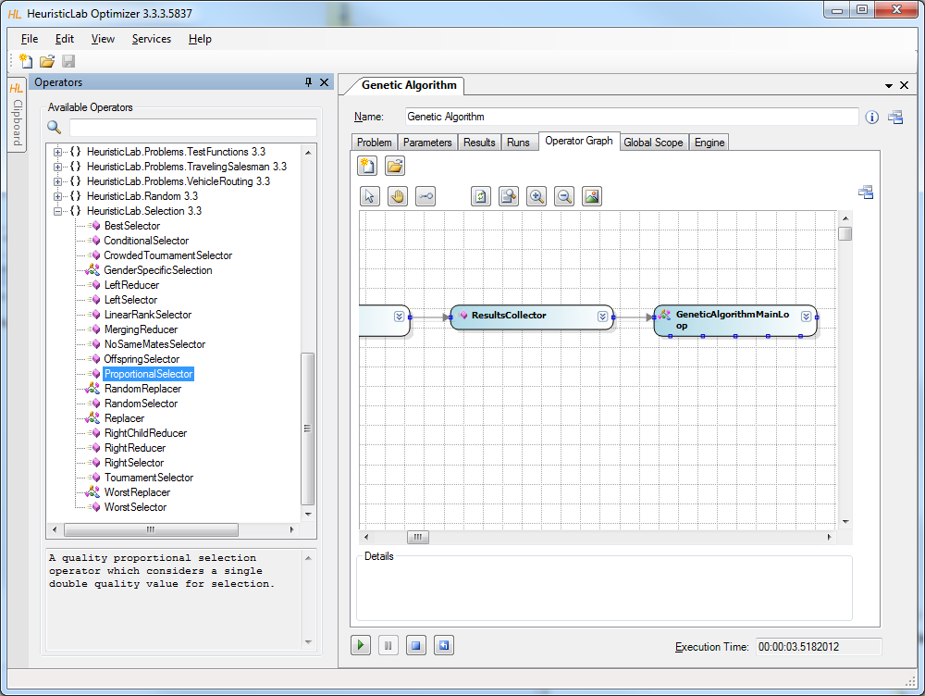
Building User-Defined Algorithms

Slide 49
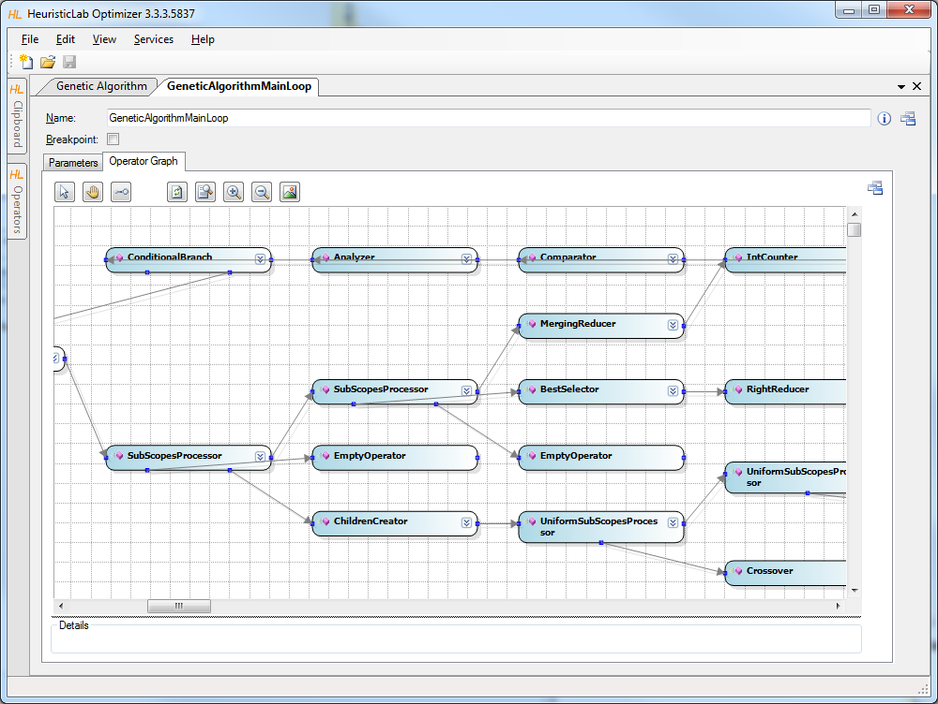
Building User-Defined Algorithms

Slide 50
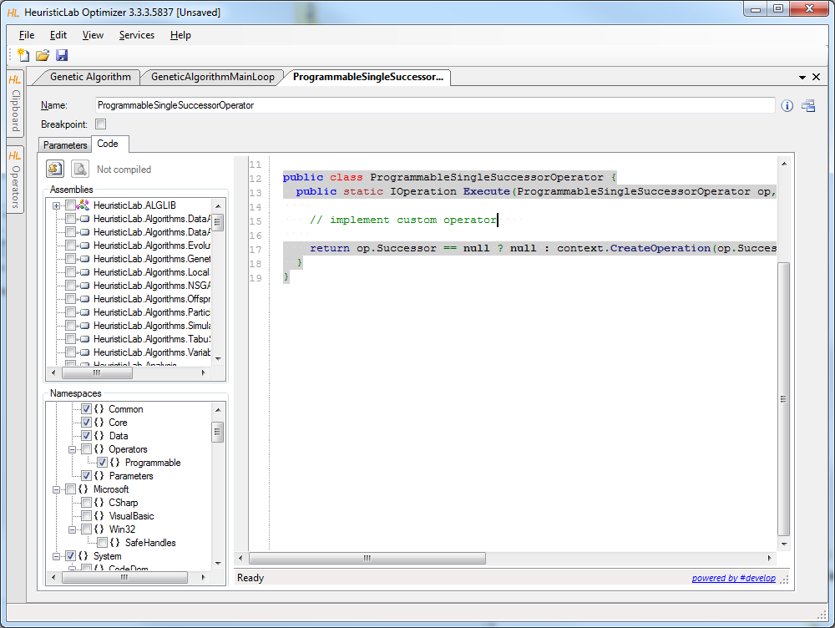
Programmable Operators

Slide 51
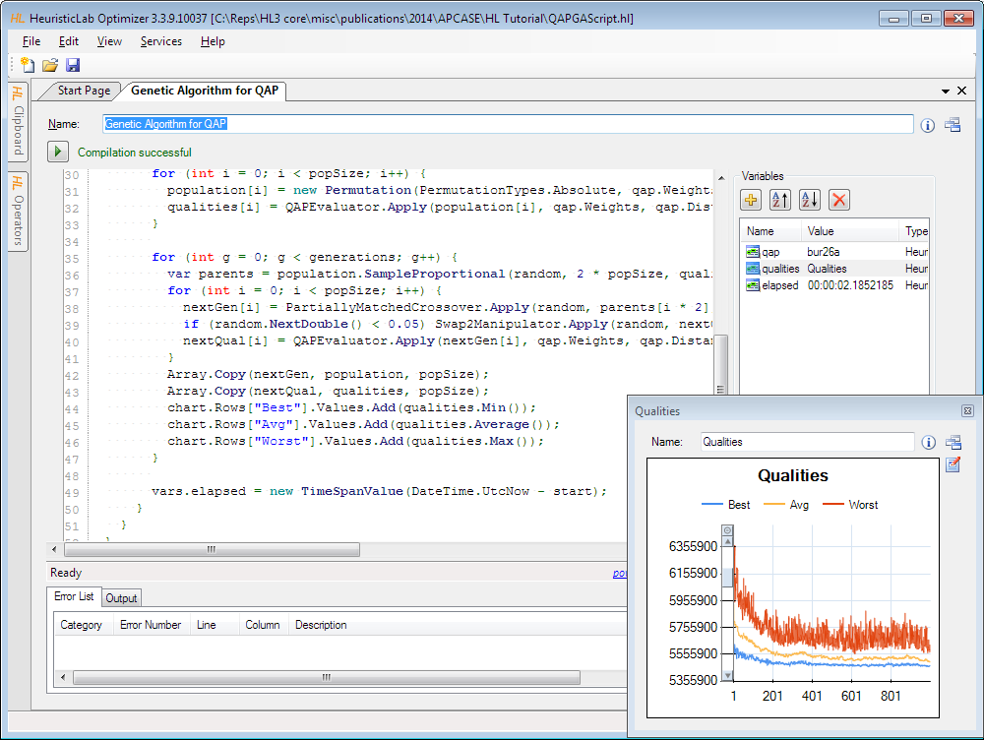
Scripting Environment

Slide 52
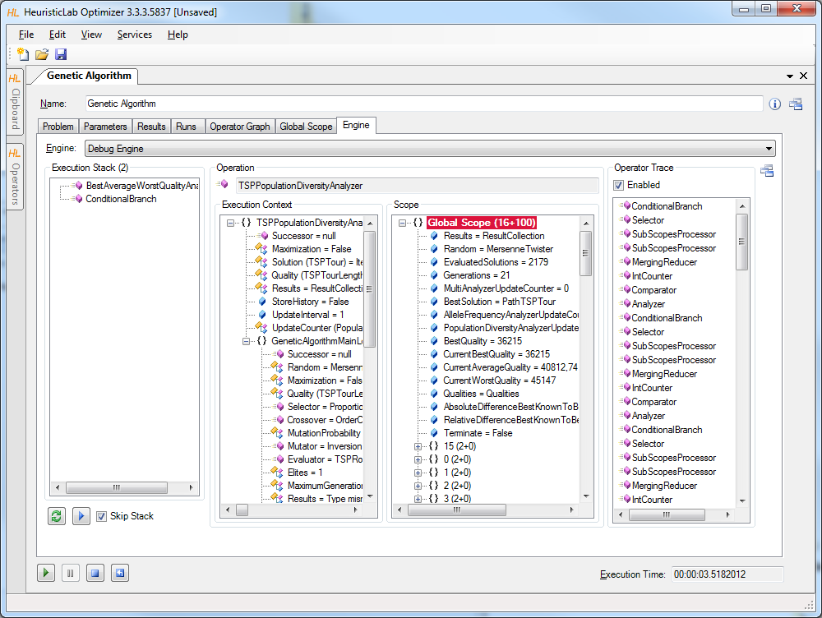
Debugging Algorithms

Slide 53
Agenda
Objectives of the Tutorial
Introduction
Where to get HeuristicLab?
Plugin Infrastructure
Graphical User Interface
Available Algorithms & Problems
Demonstration Part I: Working with HeuristicLab
Demonstration Part II: Data-based Modeling
Some Additional Features
Planned Features
Team
Suggested Readings
Bibliography
Questions & Answers

Slide 54
Demonstration Part II: Data-based Modeling
Introduction
Regression with HeuristicLab
Model simplification and export
Variable relevance analysis
Classification with HeuristicLab

Slide 55
Introduction to Data-based Modeling
Dataset: Matrix (x_{i,j}) _{i=1..N, j= 1..K}
N observations of K input variables
x_{i,j} = i-th observation of j-th variable
Additionally: Vector of labels (y₁…y_{N})^{T}
Goal: learn association of input variable values to labels
Common tasks
Regression (real-valued labels)
Classification (discrete labels)
Clustering (no labels, group similar observations)

Slide 56
Data-based Modeling Algorithms in HeuristicLab
Symbolic regression and classification using genetic programming
External Libraries:
Linear Regression, Linear Discriminate Analysis
K-Means clustering
Support Vector Machines

Slide 57
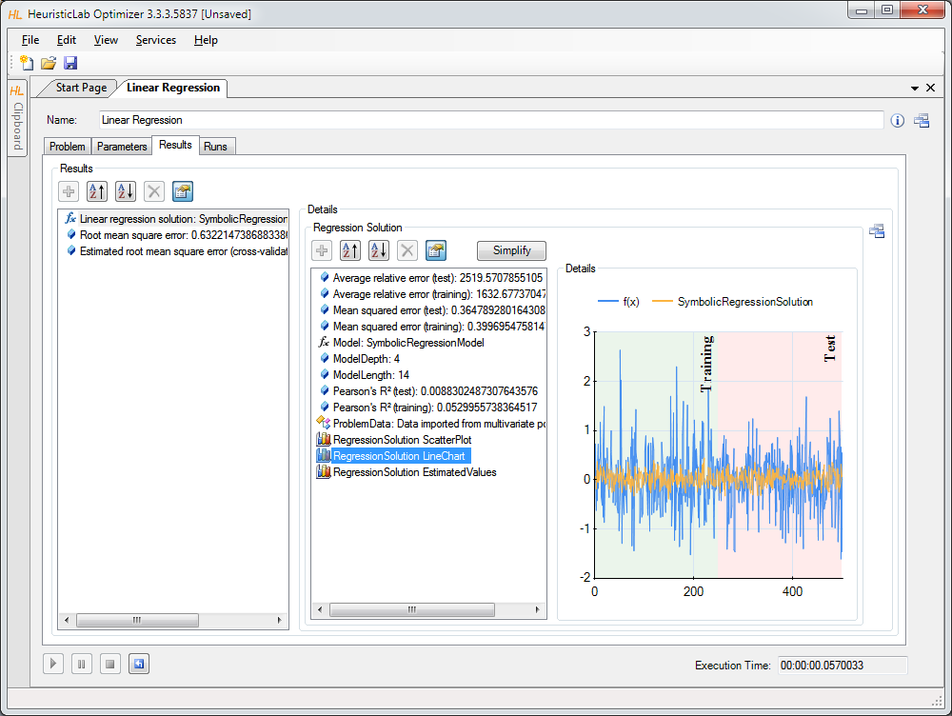
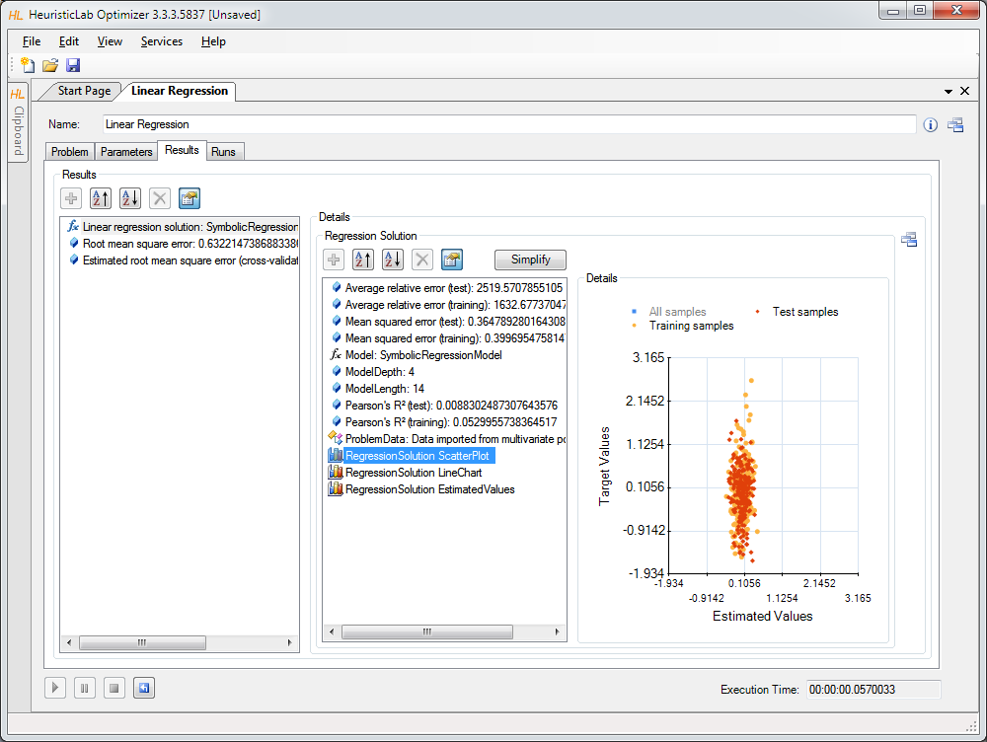
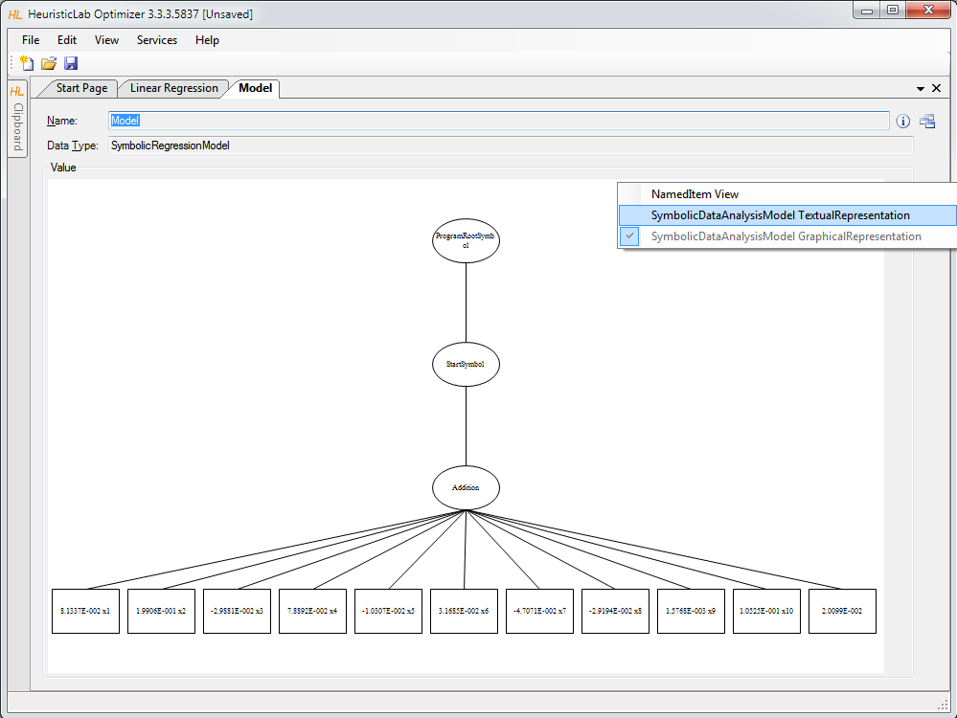
Case Studies
Demonstration
problem configuration
data import
target variable
input variables
data partitions (training and test)
analysis of results
accuracy metrics
visualization of model output

Slide 58
Case Study: Regression
Poly-10 benchmark problem dataset
10 input variables x₁ … x₁₀
y = x₁ ∙ x₂ + x₃ ∙ x₄ + x₅ ∙ x₆ + x₁ ∙ x₇ ∙ x₉ + x₃ ∙ x₆ ∙ x₁₀
non-linear modeling approach necessary
frequently used in GP literature
download http://dev.heuristiclab.com/AdditionalMaterial#GECCO2012

Slide 59
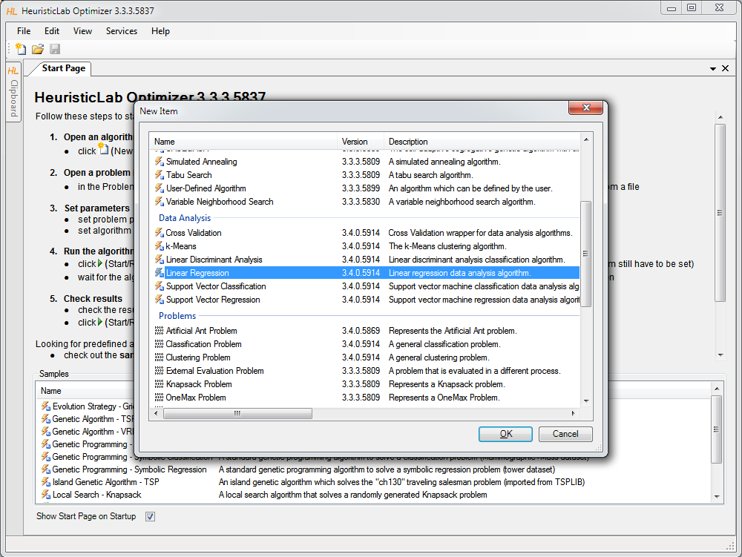
Linear Regression
Create new algorithm

Slide 60
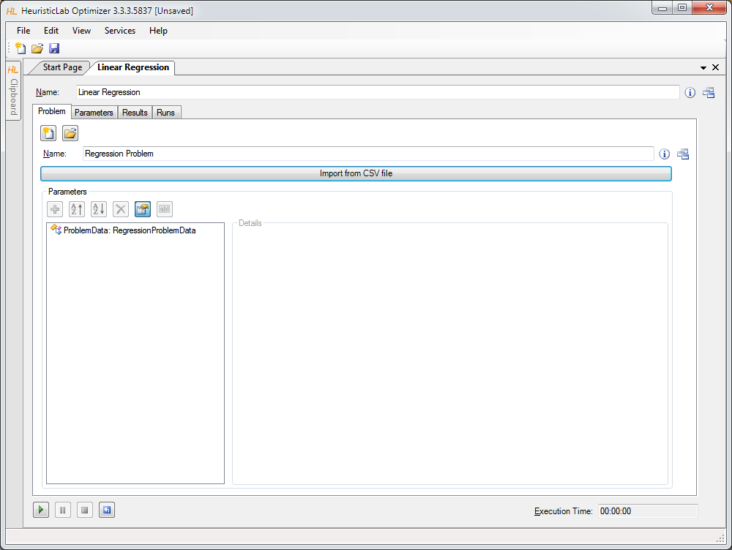
Import Data from CSV-File

Slide 61
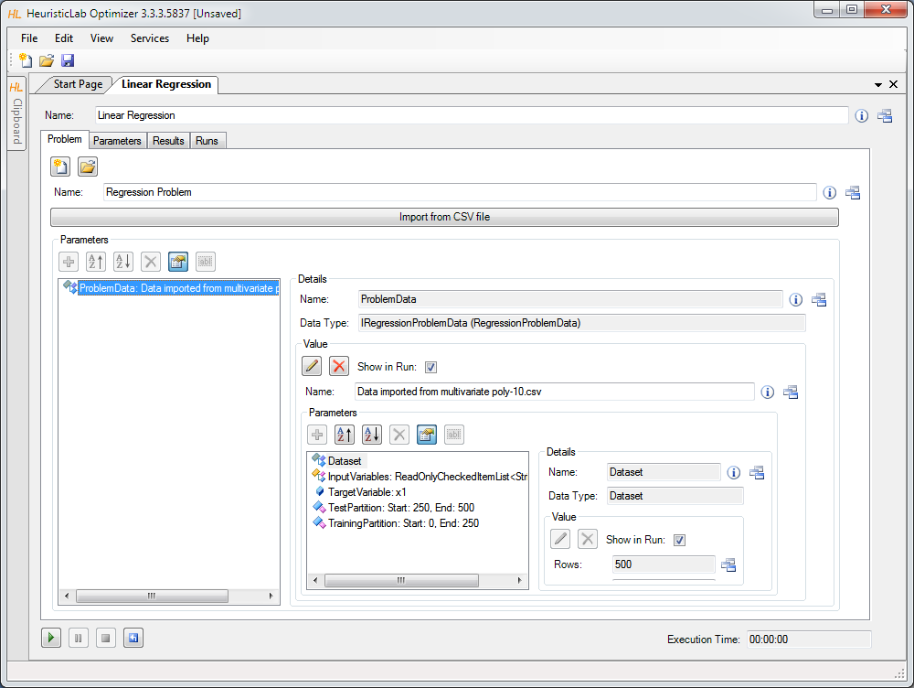
Inspect and Configure Dataset

Slide 62
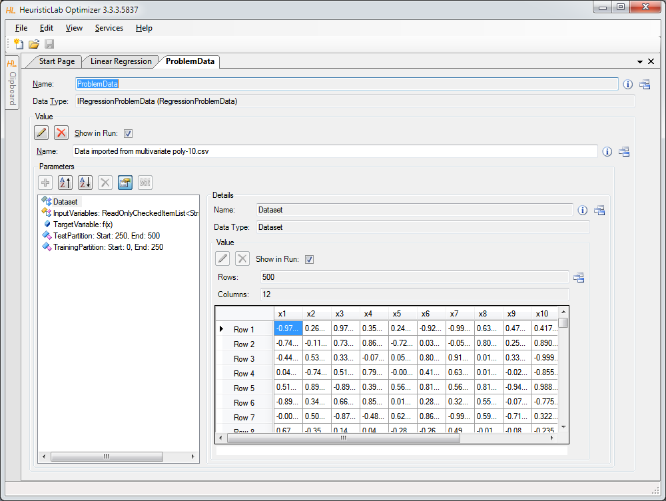
Inspect Imported Data

Slide 63
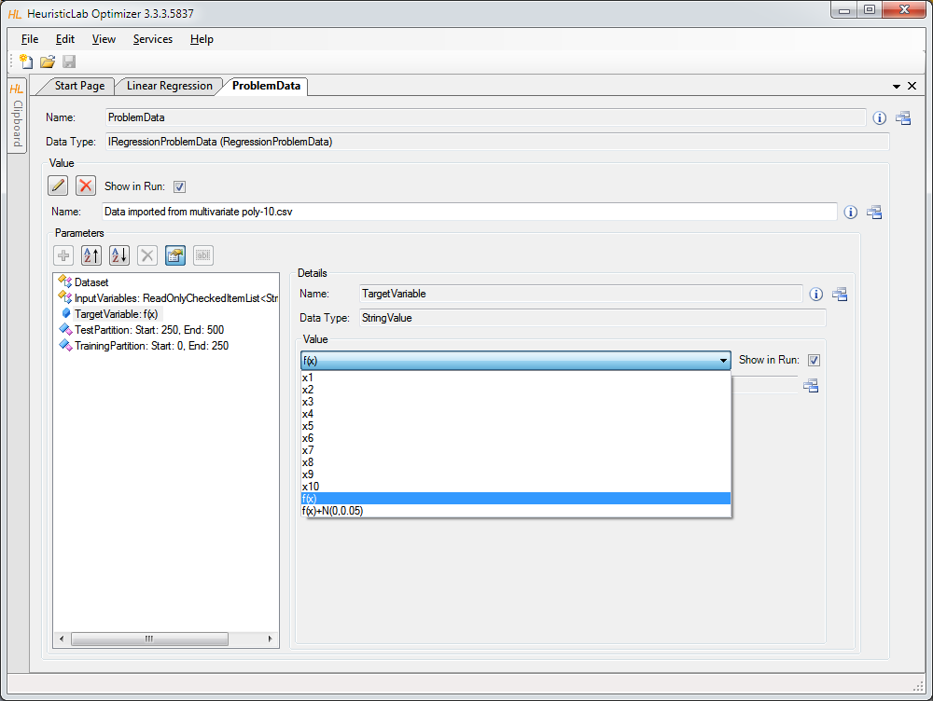
Set Target Variable

Slide 64

Select Input Variables

Slide 65

Configure Training and Test Partitions

Slide 66

Run Linear Regression

Slide 67

Inspect Results

Slide 68
Inspect Scatterplot of Predicted and Target Values

Slide 69
Inspect Linechart

Slide 70


Inspect the Model

Slide 71
Symbolic Regression with HeuristicLab
Linear regression produced an inaccurate model.
Next: produce a nonlinear symbolic regression model using genetic programming
Genetic programming
evolve variable-length models
model representation: symbolic expression tree
structure and model parameters are evolved side-by-side
white-box models
-
+
x3
x1
*
x1
x2

Slide 72


Symbolic Regression with HeuristicLab
Demonstration
problem configuration
function set and terminal set
model size constraints
Evaluation
Algorithm configuration
selection
Mutation
Analysis of results
model accuracy
model structure and parameters

Slide 73

Create New Genetic Algorithm

Slide 74

Create New Symbolic Regression Problem

Slide 75

Import Data

Slide 76

Inspect Data and Configure Dataset

Slide 77

Set Target and Input Variables

Slide 78

Configure Maximal Model Depth and Length

Slide 79

Configure Function Set (Grammar)

Slide 80

Configure Function Set (Grammar)

Slide 81

Configure Algorithm Parameters

Slide 82

Configure Mutation Operator

Slide 83

Configure Selection Operator

Slide 84

Configure Tournament Group Size

Slide 85

Start Algorithm and Inspect Results

Slide 86

Inspect Quality Chart

Slide 87

Inspect Best Model on Training Partition

Slide 88

Inspect Linechart of Best Model on Training Partition

Slide 89
Inspect Structure of Best Model on Training Partition

Slide 90


Model Simplification and Export
Demonstration
automatic simplification
visualization of node impacts
manual simplification
online update of results
model export
Excel
MATLAB
LaTeX

Slide 91

Detailed Model Analysis and Simplification

Slide 92

Symbolic Simplification and Node Impacts

Slide 93

Manual Simplification
double-click nodes

Slide 94
Automatic Symbolic Simplification

Slide 95
Textual Representations Are Also Available
Use ViewHost to switch to textual representation view.

Slide 96

Default Textual Representation for Model Export

Slide 97


Textual Representation for Export to LaTeX

Slide 98

LaTeX Export

Slide 99


Variable Relevance Analysis
Which variables are important to predict classes correctly?
Demonstration
Variable frequency analyzer
symbol frequency analyzer
variable impacts

Slide 100
Inspect Variable Frequency Chart

Slide 101
Inspect Variable Impacts

Slide 102

Inspect Symbol Frequencies

Slide 103



Classification with HeuristicLab
Symbolic classification
evolve discriminating function using GP
find thresholds to assign classes
Demonstration
real world medical application
model accuracy
visualization of model output
discriminating function output
ROC-curve
confusion matrix

Slide 104
Case Study: Classification
Real world medical dataset (Mammographic Mass) from UCI Machine Learning Repository
data from non-invasive mammography screening
variables:
patient age
visual features of inspected mass lesions: shape, margin, density
target variable: severity (malignant, benign)
download http://dev.heuristiclab.com/AdditionalMaterial#GECCO2012

Slide 105

Open Sample

Slide 106

Configure and Run Algorithm

Slide 107

Inspect Quality Linechart

Slide 108

Inspect Best Training Solution

Slide 109
Inspect Model Output and Thresholds

Slide 110
Inspect Confusion Matrix

Slide 111
Inspect ROC Curve

Slide 112


Validation of Results
Overfitting = memorizing data
Strategies to reduce overfitting
validation partition
cross-validation

Slide 113



Validation of Results
Demonstration
Configuration of a validation set
Inspection of best solution on validation set
Analysis of training- and validation fitness correlation
Cross-validation
Configuration
Analysis of results

Slide 114

Configuration of Validation Partition

Slide 115

Inspect Best Model on Validation Partition

Slide 116
Inspect Linechart of Correlation of Training and Validation Fitness

Slide 117
Agenda
Objectives of the Tutorial
Introduction
Where to get HeuristicLab?
Plugin Infrastructure
Graphical User Interface
Available Algorithms & Problems
Demonstration Part I: Working with HeuristicLab
Demonstration Part II: Data-based Modeling
Some Additional Features
Planned Features
Team
Suggested Readings
Bibliography
Questions & Answers

Slide 118

Some Additional Features
HeuristicLab Hive
parallel and distributed execution of algorithms and experiments on many computers in a network
Optimization Knowledge Base (OKB)
database to store algorithms, problems, parameters and results
open to the public
open for other frameworks
analyze and store characteristics of problem instances and problem classes
External solution evaluation and simulation-based optimization
interface to couple HeuristicLab with other applications (MATLAB, AnyLogic, …)
supports different protocols (command line parameters, TCP, …)
Parameter grid tests and meta-optimization
automatically create experiments to test large ranges of parameters
apply heuristic optimization algorithms to find optimal parameter settings for heuristic optimization algorithms

Slide 119
Planned Features
Algorithms & Problems
steady-state genetic algorithm
unified tabu search for vehicle routing
estimation of distribution algorithms
…
Cloud Computing
port HeuristicLab Hive to Windows Azure
Statistics
implement statistical tests and automated statistical analysis
Have a look at the HeuristicLab roadmap
http://dev.heuristiclab.com/trac/hl/core/roadmap
Any other ideas, requests or recommendations?
join our HeuristicLab Google group heuristiclab@googlegroups.com
write an e-mail to support@heuristiclab.com

Slide 120

HeuristicLab Team
Heuristic and Evolutionary Algorithms Laboratory (HEAL)
School of Informatics, Communications and Media
University of Applied Sciences Upper Austria
Softwarepark 11
A-4232 Hagenberg
AUSTRIA
WWW: http://heal.heuristiclab.com

Slide 121


Suggested Readings
S. Voß, D. Woodruff (Edts.) Optimization Software Class Libraries Kluwer Academic Publishers, 2002
M. Affenzeller, S. Winkler, S. Wagner, A. Beham Genetic Algorithms and Genetic Programming Modern Concepts and Practical Applications CRC Press, 2009

Slide 122
Bibliography
S. Wagner, M. Affenzeller HeuristicLab: A generic and extensible optimization environment Adaptive and Natural Computing Algorithms, pp. 538-541 Springer, 2005
S. Wagner, S. Winkler, R. Braune, G. Kronberger, A. Beham, M. Affenzeller Benefits of plugin-based heuristic optimization software systems Computer Aided Systems Theory - EUROCAST 2007, Lecture Notes in Computer Science, vol. 4739, pp. 747-754 Springer, 2007
S. Wagner, G. Kronberger, A. Beham, S. Winkler, M. Affenzeller Modeling of heuristic optimization algorithms Proceedings of the 20th European Modeling and Simulation Symposium, pp. 106-111 DIPTEM University of Genova, 2008
S. Wagner, G. Kronberger, A. Beham, S. Winkler, M. Affenzeller Model driven rapid prototyping of heuristic optimization algorithms Computer Aided Systems Theory - EUROCAST 2009, Lecture Notes in Computer Science, vol. 5717, pp. 729-736 Springer, 2009
S. Wagner Heuristic optimization software systems - Modeling of heuristic optimization algorithms in the HeuristicLab software environment Ph.D. thesis, Johannes Kepler University Linz, Austria, 2009.
S. Wagner, A. Beham, G. Kronberger, M. Kommenda, E. Pitzer, M. Kofler, S. Vonolfen, S. Winkler, V. Dorfer, M. Affenzeller HeuristicLab 3.3: A unified approach to metaheuristic optimization Actas del séptimo congreso español sobre Metaheurísticas, Algoritmos Evolutivos y Bioinspirados (MAEB'2010), 2010
S. Wagner, G. Kronberger, A. Beham, M. Kommenda, A. Scheibenpflug, E. Pitzer, S. Vonolfen, M. Kofler, S. Winkler, V. Dorfer, M. Affenzeller
Architecture and Design of the HeuristicLab Optimization Environment
Advanced Methods and Applications in Computational Intelligence, vol. 6, pp. 197-261, Springer, 2014
Detailed list of all publications of the HEAL research group: http://research.fh-ooe.at/de/orgunit/detail/356#showpublications

Slide 123
Questions & Answers
http://dev.heuristiclab.com
heuristiclab@googlegroups.com
http://www.youtube.com/heuristiclab
http://www.facebook.com/heuristiclab

